Slide 1
Chem 108: Lab
Week 9
Sign in
Pick up handouts plus a scantron
Sit at your lab station
i.e. where your lab drawer is located
Today’s Experiments: Chemical Reactions I & II
Chemical Reactions I: Fermentation, Synthesis of Ethanol
Chemical Reactions II: General Reactions
Both sets of procedures are to be completed today.
Select a partner; Procedures pg. 62 & pp.44-45

Slide 2
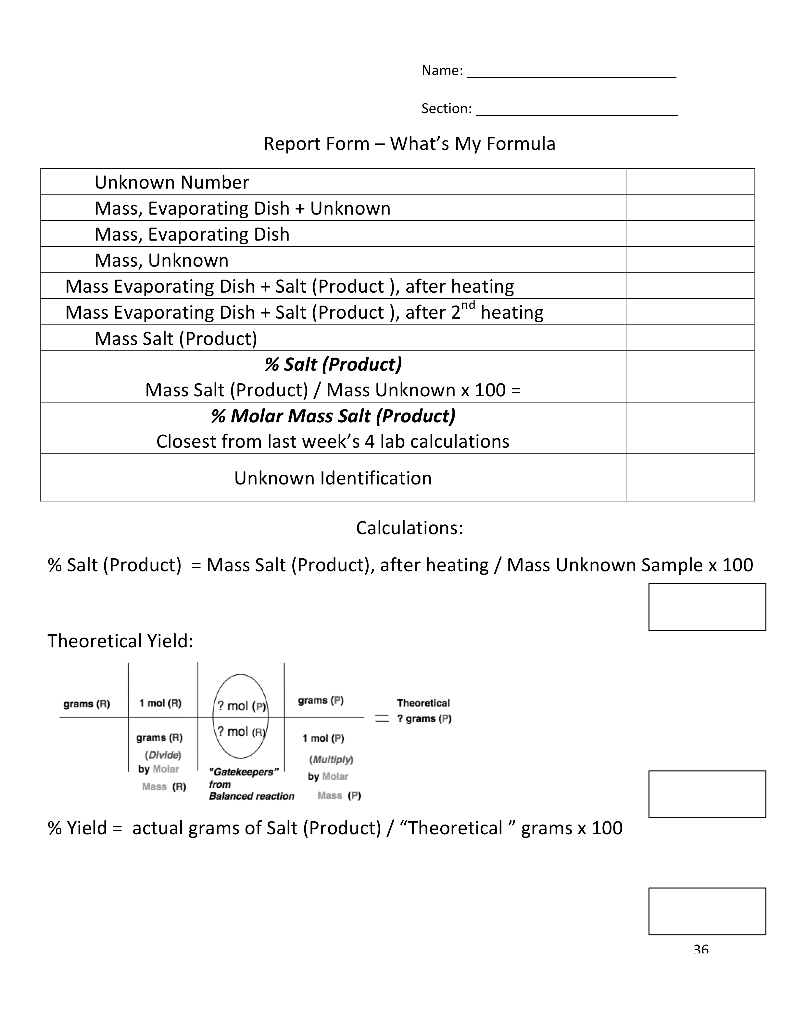
S. Curry (D. Green)
What’s My Formula?
and on your partner’s form
DUE Today:
D. Green (S. Curry)
ONE Complete Group Report
(Pages Stapled Together)
Confer with Group members after completing today’s Lab procedures with your partner and getting the data pages signed by Dr. R.

Slide 3
What’s My Formula?
S. Curry (D. Green)
DUE Today:
and on your partner’s form
D. Green (S. Curry)
ONE Complete Group Report
(Pages Stapled Together)
Confer with Group members after completing today’s Lab procedures with your partner.
Each group member is to contribute one completed replacement pg. 36 handout with their own name first followed by partners’ names of all members in entire group. The unknown number(s) should be the one(s) worked on, in the order worked on.
There must be one form for each unknown including bonus samples.

Slide 4
S. Curry (D. Green)
What’s My Formula?
and on your partner’s form
D. Green (S. Curry)
ONE Complete Group Report
(Pages Stapled Together)
Each page 36 must have a complete set of clear calculations for the unknown ‘s number to include % Yield & Theoretical Yield Calculations for the respective unknown.
DUE Today:

Slide 5
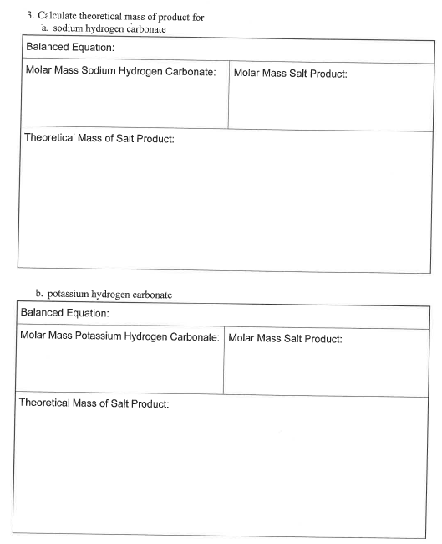
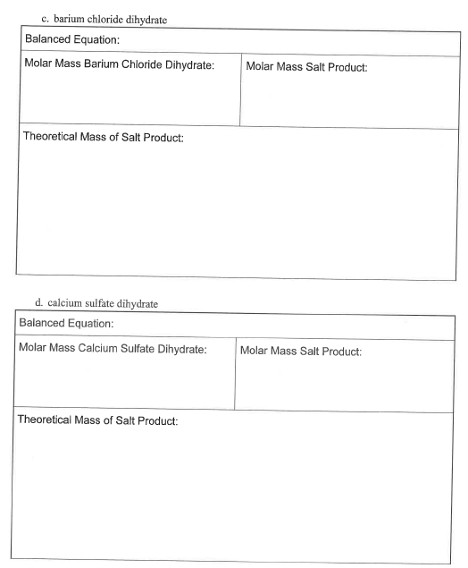
What’s My Formula?
DUE Today:
ONE Complete Group Report
(Staple Pages Together)
Completed pages 37 & 38 must have a complete set of clear
Theoretical % Mass calculations and reactions for each of the respective unknowns.
Separate pages for each unknown are acceptable.

Slide 6
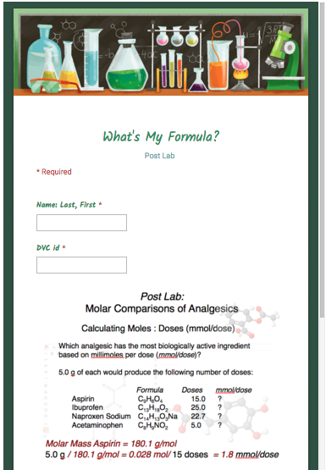
Molar Comparisons of Analgesics
Calculate Moles : Doses (mmol/dose)
What’s My Formula?
Post Lab:
Must submit Individually
From calendar link
DUE Friday

Slide 7
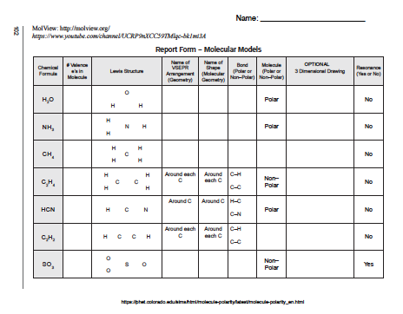
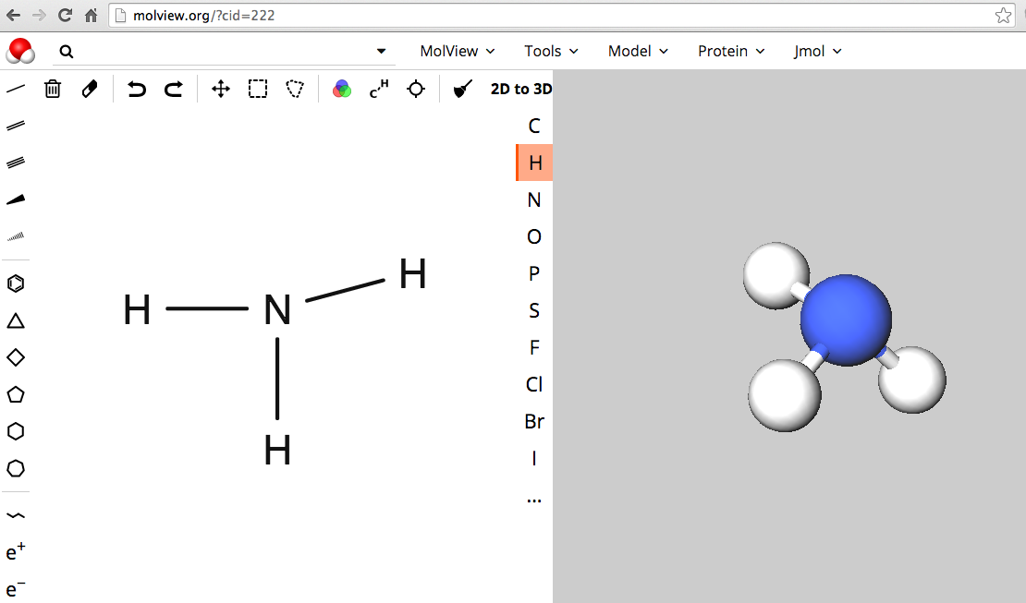
Molecular Modeling
(Collaborative Effort / Individual Report Forms)
Report Form (Replaces Molecular Model Lab pp. 102-104)
http://chemconnections.org/general/chem108/Chemistry%20108%20Molecular%20Modeling%20Form%20Fall%202019.pdf
http://chemconnections.org/general/chem108/Molecular%20Modeling-intro%20%26%20table%202019f.pdf
Turn-in individually
Due 23-Oct

Slide 8
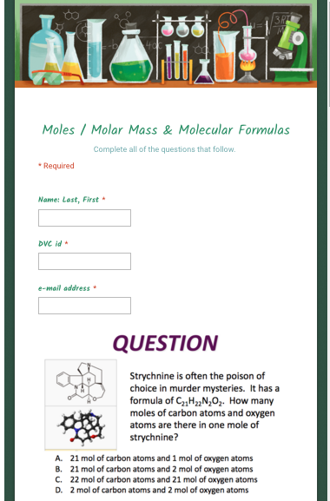
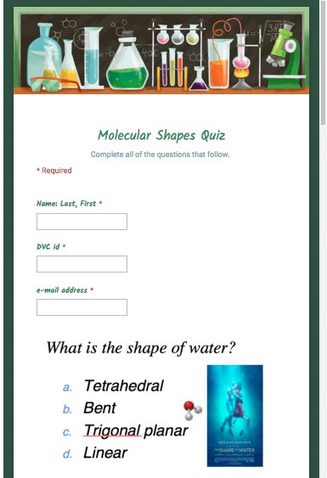
QUIZZES
Moles / Molar Mass
&
Molecular Formulas
_________
and
Molecular Shapes
Both Quizzes
DUE:
25-Oct
Submit individually on-line
Refer to Calendar & Resources pages for links

Slide 9
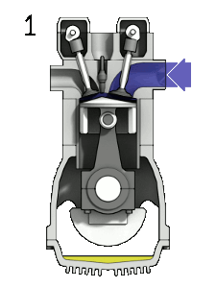
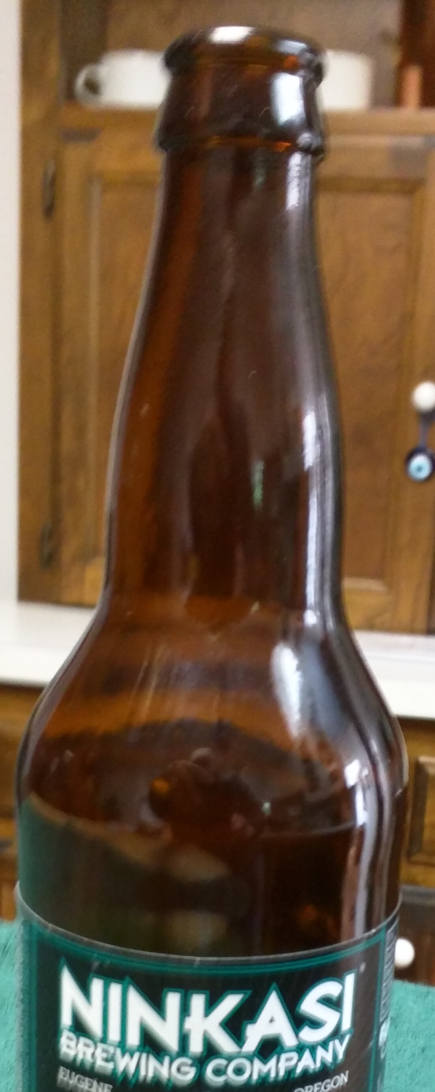
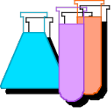
Chemical Reactions I & II
With your selected partner; Lab Manual pp.44-45. & pg. 62
Do Today
Combination (Synthesis)
Decomposition
Single Displacement
Double Displacement
Biological Reactions: Enzyme Catalysts
Fermentation pg. 62
Combustion: Oxidation-Reduction
  pp. 44-45
_________________________
http://www.piney.com/BabNinkasi.html)
Notes:
A 3900-year-old clay tablet, which was found in Iraq between the Tigris and Euphrates rivers, had a Sumerian poem (http://www.piney.com/BabNinkasi.html) honoring Ninkasi, the patron goddess of brewing. It contains the oldest surviving beer recipe, describing the fermentation of the carbohydrates found in bread, bappir, made from barley, honey, dates and sweet aromatic herbs. The global availability of carbohydrates and native microbes (yeasts) has led to the production of many different types of beers, ales, wines, and fruit based alcoholic beverages in many countries throughout the world. [The bottle on the left was found in Eugene, Oregon, ……. But, it dates only to 2016.]

Slide 10

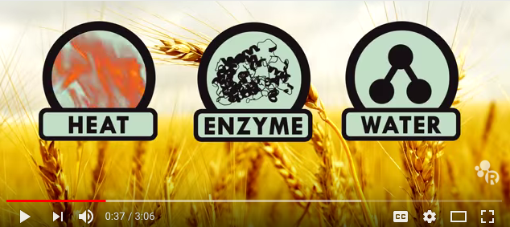
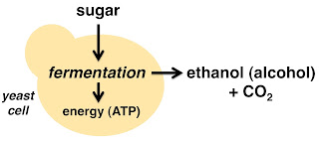
Chemical Reactions I (Biological Reaction)
Bakers’ yeast fermentation
zymase
https://www.youtube.com/watch?v=vW99JEaDApY
http://www.piney.com/BabNinkasi.html
Notes:
A 3900-year-old clay tablet, which was found in Iraq between the Tigris and Euphrates rivers, had a Sumerian poem (http://www.piney.com/BabNinkasi.html) honoring Ninkasi, the patron goddess of brewing. It contains the oldest surviving beer recipe, describing the fermentation of the carbohydrates found in bread, bappir, made from barley, honey, dates and sweet aromatic herbs. The global availability of carbohydrates and native microbes (yeasts) has led to the production of many different types of beers, ales, wines, and fruit based alcoholic beverages in many countries throughout the world. [The bottle on the left was found in Eugene, Oregon, ……. But, it dates only to 2016.]

Slide 11
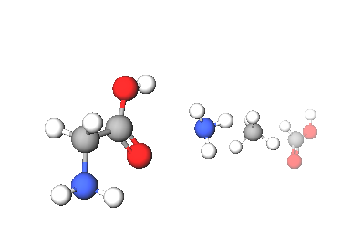
Amino Acids & Enzymes
Pre-set Legos of Chemical Biology & Bio-catalysis
Amino acids contain carbon, hydrogen, oxygen, and nitrogen, which resemble the following shapes & structural components
20 different amino acids are encoded in DNA providing a genetic code, an archive representing specific sequences of amino acids, which are linked together forming a specific protein.
Hundreds of amino acids are linked together through amide (peptide) bonds to form these proteins, some of which, enzymes, provide the catalytic basis for the chemistry of life.
There are less than 20,000 total proteins produced from humans’ entire DNA genome, each coded for by a specific gene in DNA’s ~3 billion genetic bases.
Notes:
http://www.jbc.org/content/262/2/549.short
http://pdb101.rcsb.org/motm/54
http://www.rcsb.org/pdb/explore/jmol.do?structureId=1CFJ&bionumber=1

Slide 12
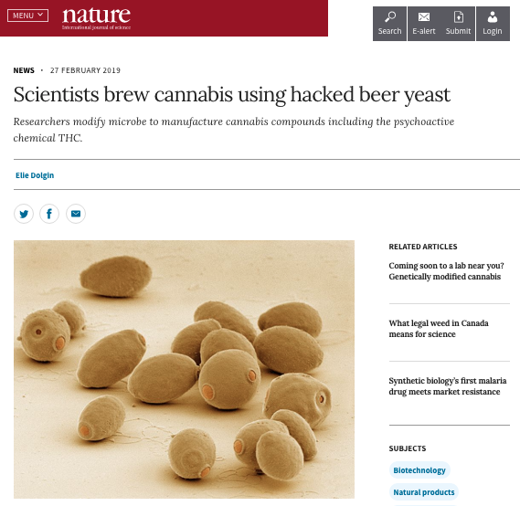
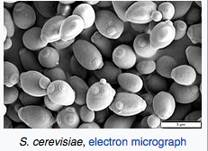
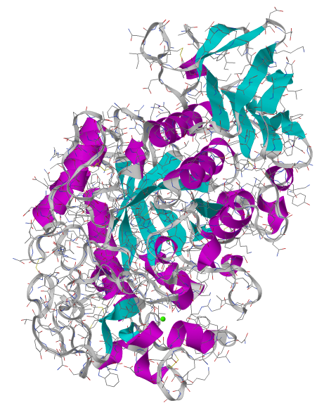
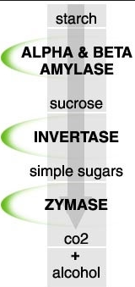
Amino Acids Proteins
Enzymes: Indispensible Biopolymers
amylase
Amylase, an enzyme, which catalyzes a key reaction in converting starches found in barley and other grains to simpler sugars, which another enzyme, zymase, ultimately converts to ethanol (alcohol).
Molar Mass: 44576 g/mol
Atoms: 3148
Amino Acid Residues: 396
Notes:
http://www.rcsb.org/pdb/explore/jmol.do?structureId=1CFJ&bionumber=1
http://pdb101.rcsb.org/motm/54
Global warming, barley & the price of beer going up.

Slide 13
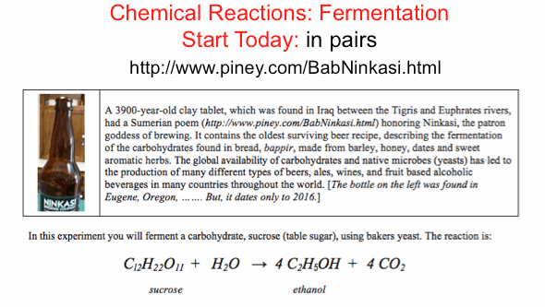
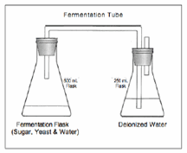
  pg. 62
zymase

Slide 14
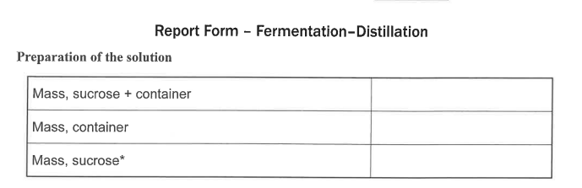
Chemical Reactions I
Biological Reactions: Enzyme Catalysts
  Fermentation
  pg. 62
  pg. 66
To Do Today
Have Dr. R. initial completed data pg. 66
Notes:
A 3900-year-old clay tablet, which was found in Iraq between the Tigris and Euphrates rivers, had a Sumerian poem (http://www.piney.com/BabNinkasi.html) honoring Ninkasi, the patron goddess of brewing. It contains the oldest surviving beer recipe, describing the fermentation of the carbohydrates found in bread, bappir, made from barley, honey, dates and sweet aromatic herbs. The global availability of carbohydrates and native microbes (yeasts) has led to the production of many different types of beers, ales, wines, and fruit based alcoholic beverages in many countries throughout the world. [The bottle on the left was found in Eugene, Oregon, ……. But, it dates only to 2016.]

Slide 15
Chemical Reactions I & II
With your partner; Complete Lab Manual pp.44-45. & pg. 62
Do Today
Combination (Synthesis)
Decomposition
Single Displacement
Double Displacement
Combustion: Oxidation-Reduction
Biological Reactions: Enzyme Catalysts
  Fermentation pg. 62
  pp. 44-45
_________________________
http://www.piney.com/BabNinkasi.html)
Notes:
A 3900-year-old clay tablet, which was found in Iraq between the Tigris and Euphrates rivers, had a Sumerian poem (http://www.piney.com/BabNinkasi.html) honoring Ninkasi, the patron goddess of brewing. It contains the oldest surviving beer recipe, describing the fermentation of the carbohydrates found in bread, bappir, made from barley, honey, dates and sweet aromatic herbs. The global availability of carbohydrates and native microbes (yeasts) has led to the production of many different types of beers, ales, wines, and fruit based alcoholic beverages in many countries throughout the world. [The bottle on the left was found in Eugene, Oregon, ……. But, it dates only to 2016.]

Slide 16
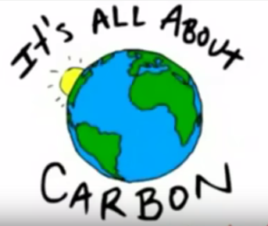
Combustion Products
Energy & CO₂
. 10/8/18
#3
https://www.youtube.com/watch?v=Q9u8vM8YjeU&index=3&list=PLE7B4FAD08F1EBCE2

Slide 17
Octane (Gas) Combustion Engine
Combustion: Oxidation-Reduction Reaction
2 C₈H_{18(l)}+ 25 O_{2(g)} 16 CO_{2(g)}+18 H₂O_{(l)} + energy
http://chemconnections.org/general/movies/4StrokeEngine_Ortho_3D_Small.gif
Notes:
<a title="By Zephyris (Own work) [CC BY-SA 3.0 (http://creativecommons.org/licenses/by-sa/3.0) or GFDL (http://www.gnu.org/copyleft/fdl.html)], via Wikimedia Commons" href="https://commons.wikimedia.org/wiki/File%3A4StrokeEngine_Ortho_3D_Small.gif"><img width="128" alt="4StrokeEngine Ortho 3D Small" src="https://upload.wikimedia.org/wikipedia/commons/d/dc/4StrokeEngine_Ortho_3D_Small.gif"/></a>

Slide 18
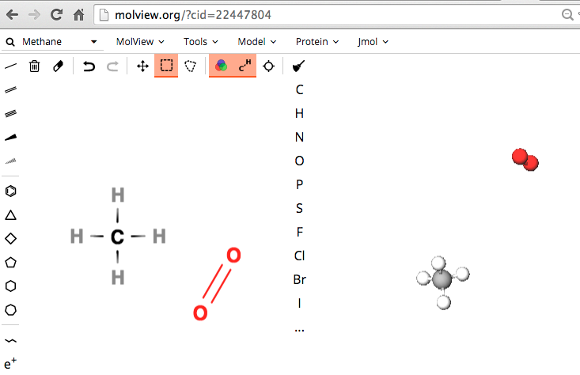

Molecular Shapes Lewis Structures
MolView: Visual On-line Molecular Modeling
http://molview.org
https://www.youtube.com/watch?v=cOJ3MUpDrfI&list=PLE7B4FAD08F1EBCE2&index=2
Bonding, Lewis Structures
Computational Experiments, Molecular Modeling

Slide 19
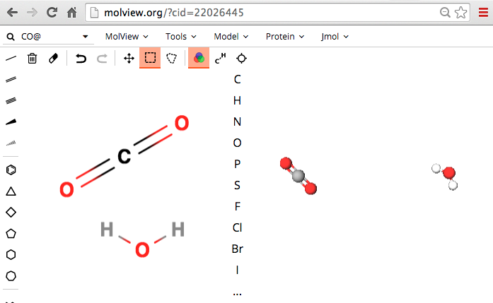
Molecular Shapes Lewis Structures
MolView: Visual On-line Molecular Modeling
http://molview.org
Bonding, Lewis Structures
Computational Experiments, Molecular Modeling

Slide 20




Combustion
1 CH_{4(g)}+ 2 O_{2(g)} 1 CO_{2(g)}+ 2 H₂O_{(g)} + energy
Bonding, Lewis Structures
Computational Experiments, Molecular Modeling
Notes:
<a title="By Zephyris (Own work) [CC BY-SA 3.0 (http://creativecommons.org/licenses/by-sa/3.0) or GFDL (http://www.gnu.org/copyleft/fdl.html)], via Wikimedia Commons" href="https://commons.wikimedia.org/wiki/File%3A4StrokeEngine_Ortho_3D_Small.gif"><img width="128" alt="4StrokeEngine Ortho 3D Small" src="https://upload.wikimedia.org/wikipedia/commons/d/dc/4StrokeEngine_Ortho_3D_Small.gif"/></a>

Slide 21
CO₂ Concentration Effects
. 10/8/18
#4
https://www.youtube.com/watch?v=EvphJO8VKlc&index=4&list=PLE7B4FAD08F1EBCE2

Slide 22
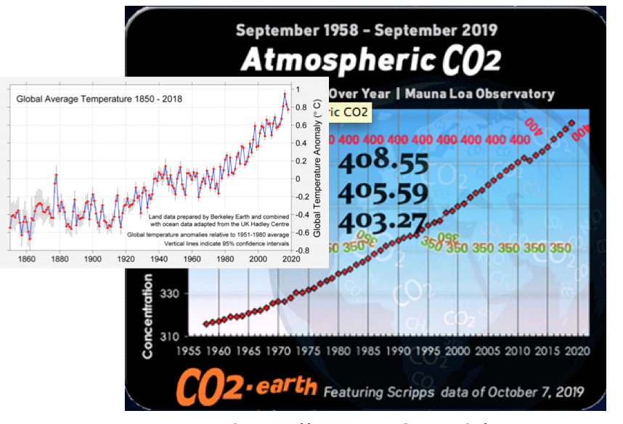
CO₂ Concentration Effects
. 10/8/18
#4
https://www.youtube.com/watch?v=EvphJO8VKlc&index=4&list=PLE7B4FAD08F1EBCE2

Slide 23
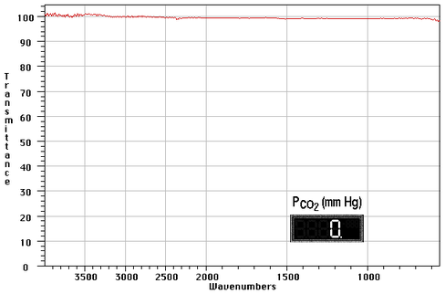
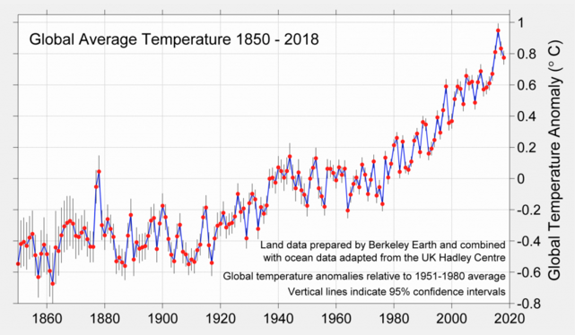
Infrared Spectra: CO₂ Concentration Effects
Nitrogen & Oxygen produce flat lines: 100% Transmission, 0 Absorbance
Turn in Global Warming scantron for quiz credit

Slide 24
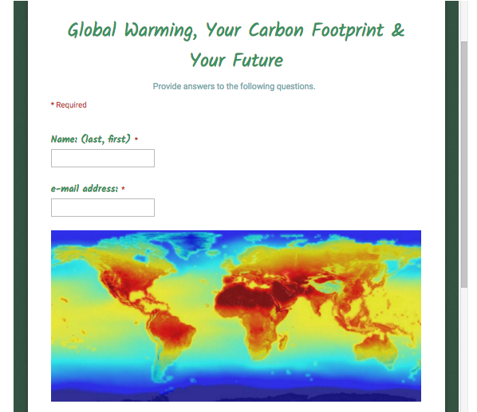
Global Warming
Survey Questions Bonus & Carbon Footprint Bonus
http://chemconnections.org/general/chem108/Global%20warming%20questions.pdf
Global Warming Survey Questions
for Quiz bonus (100% )
Turn in Completed Scantron
DUE Today
Global Warming & Your Carbon Footprint
for Exam Bonus (up to 30 pts.)
DUE On-line 11-Dec
http://chemconnections.org/general/chem108/Global%20warming%20%26%20Carbon%20Footprint.2017.pdf

Slide 25
Chemical Reactions II
Each partner is to keep individual records & reports pp. 46-52
To Do today:
Combination (Synthesis)
Decomposition
Single Displacement
Double Displacement
Combustion: Oxidation-Reduction
Biological Reactions: Enzyme Catalysts
_________________________
Have Dr. R. initial completed Lab Manual pp.46-47 plus pg. 66
Notes:
A 3900-year-old clay tablet, which was found in Iraq between the Tigris and Euphrates rivers, had a Sumerian poem (http://www.piney.com/BabNinkasi.html) honoring Ninkasi, the patron goddess of brewing. It contains the oldest surviving beer recipe, describing the fermentation of the carbohydrates found in bread, bappir, made from barley, honey, dates and sweet aromatic herbs. The global availability of carbohydrates and native microbes (yeasts) has led to the production of many different types of beers, ales, wines, and fruit based alcoholic beverages in many countries throughout the world. [The bottle on the left was found in Eugene, Oregon, ……. But, it dates only to 2016.]

Slide 26
Chemical Reactions
Individual reports are to be turned in,
Laboratory Manual: Report Form
pp.46-52 DUE Next Week
_________________________
Post Lab: On-line Balancing Equations DUE Next Week
Notes:
A 3900-year-old clay tablet, which was found in Iraq between the Tigris and Euphrates rivers, had a Sumerian poem (http://www.piney.com/BabNinkasi.html) honoring Ninkasi, the patron goddess of brewing. It contains the oldest surviving beer recipe, describing the fermentation of the carbohydrates found in bread, bappir, made from barley, honey, dates and sweet aromatic herbs. The global availability of carbohydrates and native microbes (yeasts) has led to the production of many different types of beers, ales, wines, and fruit based alcoholic beverages in many countries throughout the world. [The bottle on the left was found in Eugene, Oregon, ……. But, it dates only to 2016.]

Slide 27
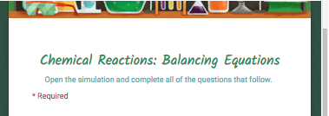
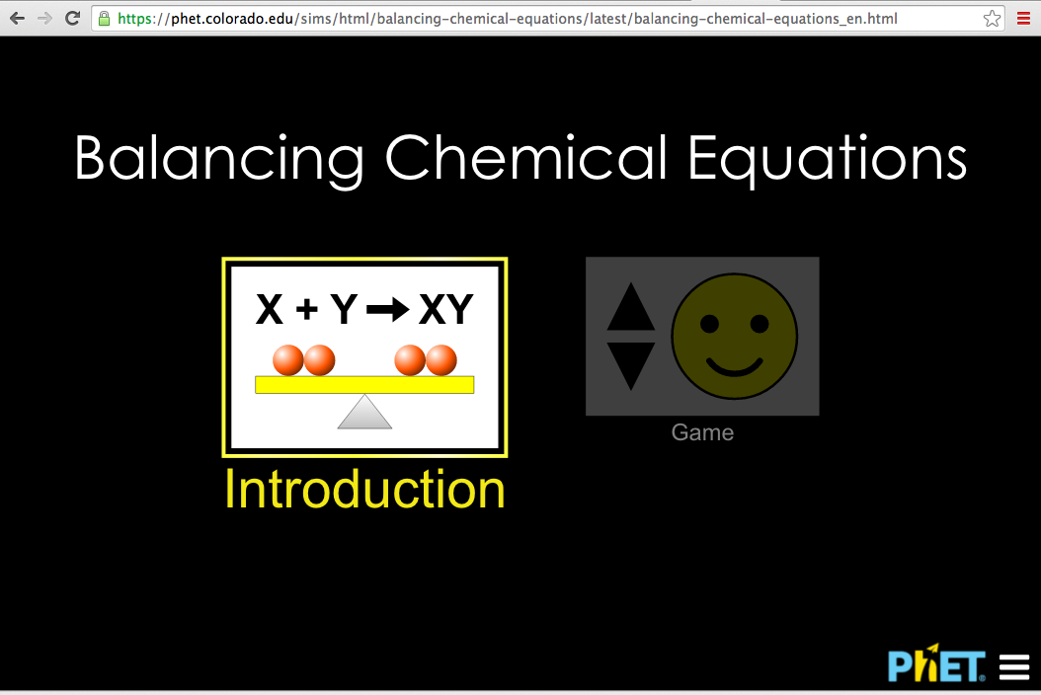
DUE Next Week
Post lab : On-line Balancing Equations
https://phet.colorado.edu/sims/html/balancing-chemical-equations/latest/balancing-chemical-equations_en.html

